Slide 1
Campus Recruitment Training (CRT)
Web Development
HTML + CSS + JavaScript

Slide 2
1. Introduction to HTML: Tags, elements, and structure
HTML stands for Hyper Text Markup Language
HTML is the standard markup language for creating Web pages
HTML describes the structure of a Web page
HTML consists of a series of elements
HTML elements tell the browser how to display the content
HTML elements label pieces of content such as "this is a heading", "this is a paragraph", "this is a link", etc.

Slide 3
1. Introduction to HTML: Tags, elements, and structure
A Simple HTML Document (Home Page)
<!DOCTYPE html> <html> <head> <title>Page Title</title> </head> <body> <h1>My First Heading</h1> <p>My first paragraph.</p> </body> </html>

Slide 4
2. HTML Document Structure: Head, body, and doctype
The <!DOCTYPE html> declaration defines that this document is an HTML5 document
The <html> element is the root element of an HTML page
The <head> element contains meta information about the HTML page
The <title> element specifies a title for the HTML page
(which is shown in the browser's title bar or in the page's tab)
The <body> element defines the document's body, and is a container for all the
visible contents, such as headings, paragraphs, images, hyperlinks, tables,
lists, etc.
The <h1> element defines a large heading
The <p> element defines a paragraph

Slide 5
3. Text Formatting: Headings, paragraphs, and emphasis
Formatting elements were designed to display special types of text:
<b> - Bold text
<strong> - Important text
<i> - Italic text
<em> - Emphasized text
<mark> - Marked text
<small> - Smaller text
<del> - Deleted text
<ins> - Inserted text
<sub> - Subscript text
<sup> - Superscript text
<pre> - Poem’s problem

Slide 6
3. Text Formatting: Headings, paragraphs, and emphasis
<q> tag defines a short quotation.
<abbr> tag defines an abbreviation or an acronym
<address> tag defines the contact information for the author/owner of a document
or an article.
<cite> tag defines the title of a creative work (e.g. a book, a poem, a song, a movie,
a painting, a sculpture, etc.).
<bdo> tag is used to override the current text direction:

Slide 7
3. Text Formatting: Headings, paragraphs, and emphasis
HTML Comment Tag
HTML comments are not displayed in the browser, but they can help document your HTML source code.
Notice that there is an exclamation point (!) in the start tag, but not in the end tag.
Hide Content
Comments can be used to hide content.
This can be helpful if you hide content temporarily:
Hide Inline Content
Comments can be used to hide parts in the middle of the HTML code.

Slide 8
4. Working with Links: Anchor tags and hyperlinks
HTML links are hyperlinks.
You can click on a link and jump to another document.
When you move the mouse over a link, the mouse arrow will turn into a little hand.

Slide 9
4. Working with Links: Anchor tags and hyperlinks
By default, links will appear as follows in all browsers:
An unvisited link is underlined and blue
A visited link is underlined and purple
HTML Links - The target Attribute
The target attribute specifies where to open the linked document.
_self - Default. Opens the document in the same window/tab as it was clicked
_blank - Opens the document in a new window or tab

Slide 10
4. Working with Links: Anchor tags and hyperlinks
Absolute URLs
An absolute URL - points to another web site
(like src="http://www.example.com/image.gif")
Relative URLs
A relative URL - points to a file within a web site
(like src="image.gif")
HTML Links - Use an Image as a Link
To use an image as a link, put the <img> tag inside the <a> tag:

Slide 11
5. Working with Images: Image tags and attributes
How to insert an image:
HTML Images Syntax
The HTML <img> tag is used to embed an image in a web page.
Images are not technically inserted into a web page; images are linked to web pages. The <img> tag creates a holding space for the referenced image.
The <img> tag is empty, it contains attributes only, and does not have a closing tag.
The <img> tag has two required attributes:
src - Specifies the path to the image
alt - Specifies an alternate text for the image

Slide 12
5. Working with Images: Image tags and attributes
Add Image border (with CSS)
How to insert images from another folder
From another web site
How to add a hyperlink to an image

Slide 13
6. Lists: Ordered and unordered lists
An unordered HTML list:
Item
Item
Item
An ordered HTML list:
First item
Second item
Third item
Nested HTML Lists (list inside list)
Ordered
Unordered

Slide 14
6. Lists: Ordered and unordered lists
Unordered HTML List - Choose List Item Marker
Value | Description
disc | Sets the list item marker to a bullet (default)
circle | Sets the list item marker to a circle
square | Sets the list item marker to a square
none | The list items will not be marked

Slide 15
6. Lists: Ordered and unordered lists
Ordered HTML List - The Type Attribute
Type | Description
type="1" | The list items will be numbered with numbers (default)
type="A" | The list items will be numbered with uppercase letters
type="a" | The list items will be numbered with lowercase letters
type="I" | The list items will be numbered with uppercase roman numbers
type="i" | The list items will be numbered with lowercase roman numbers

Slide 16
7. Tables: Creating tables and formatting data
HTML Table
How to right-align a table (with CSS)
How to add background-color to a table (with CSS)
How to add padding to a table (with CSS)
How to set table width (with CSS)
How to define table cells that span more than one row or one column

Slide 17
8. Forms: Form elements and input types
<input>
<label> and for attribute
<select> and <option>
<textarea>
<button>
<fieldset> and <legend>
<input type="button">
<input type="checkbox">
<input type="color">
<input type="date">
<input type="email">
<input type="file">
<input type="image">
<input type="month">
<input type="number">
<input type="password">
<input type="radio">
<input type="range">
<input type="reset">
<input type="search">
<input type="submit">
<input type="text">
<input type="time">
<input type="week">

Slide 18
9. Form Validation: Client-side form validation
Form validation?
"This field is required" (You can't leave this field blank).
"Please enter your phone number in the format xxx-xxxx" (A specific data format is required for it to be considered valid).
"Please enter a valid email address" (the data you entered is not in the right format).
"Your password needs to be between 8 and 30 characters long and contain one uppercase letter, one symbol, and a number." (A very specific data format is required for your data).

Slide 19
9. Form Validation: Client-side form validation
Why we need to validate a form:
We want to get the right data, in the right format.

Slide 20
9. Form Validation: Client-side form validation
Built-in form validation
required attribute
type attribute
pattern attribute
min, max attribute
minlength, maxlength attribute

Slide 21
10. Multimedia: Audio and video elements
Insert <video> in a webpage
Insert <audio> in a webpage
Insert <iframe> in a webpage

Slide 22

Cascading Style Sheets (CSS)

Slide 23
11. Introduction to CSS
What is CSS?
CSS stands for Cascading Style Sheets.
CSS is the language we use to style an HTML document.
CSS describes how HTML elements should be displayed.
CSS can be added to HTML documents in 3 ways:
(1) Inline (2) Internal (3) External

Slide 24
11. Introduction to CSS: Syntax
CSS Syntax
selector{
property1: value1;
property2: value2;
}

Slide 25
11. Introduction to CSS: selectors
Simple selectors (select elements based on name (p), id (#), class(.))
Combinator selectors (descendant (space), child (>))
Pseudo-class selectors (Anchor Pseudo-classes (a:hover), Div Pseudo-classes (div:hover))
Pseudo-elements selectors (p::first-line, p::first-letter)
Attribute selectors (input[type="text"], input[type="button"])

Slide 26
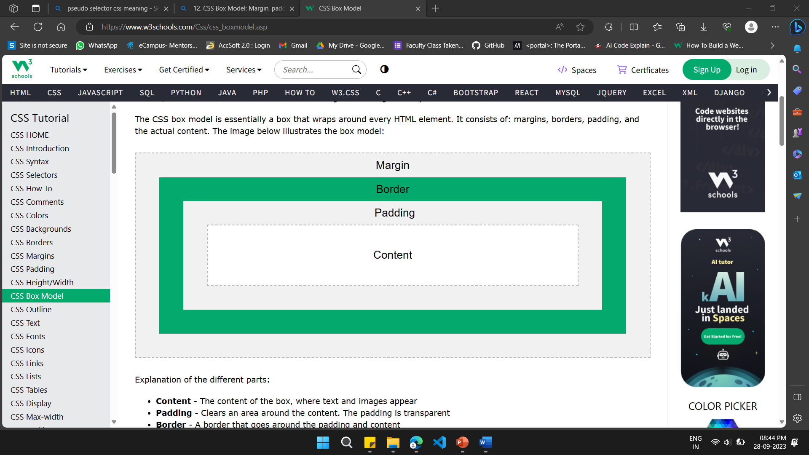
12. CSS Box Model: Margin, padding, and border
The CSS Box Model

Slide 27
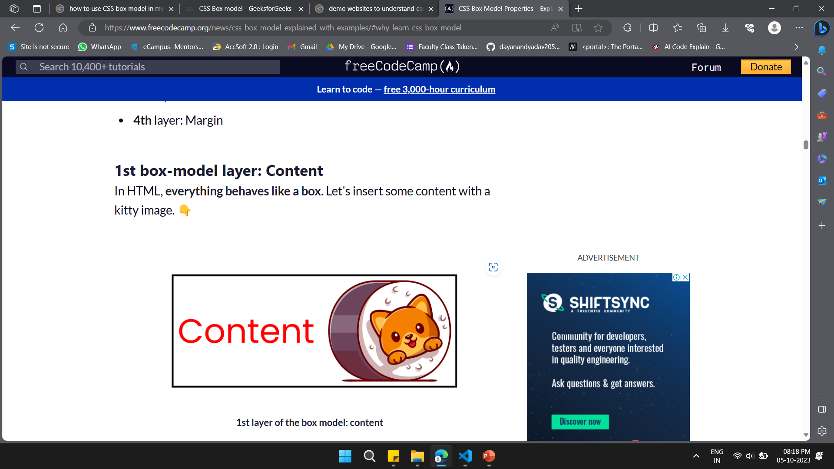

Slide 28
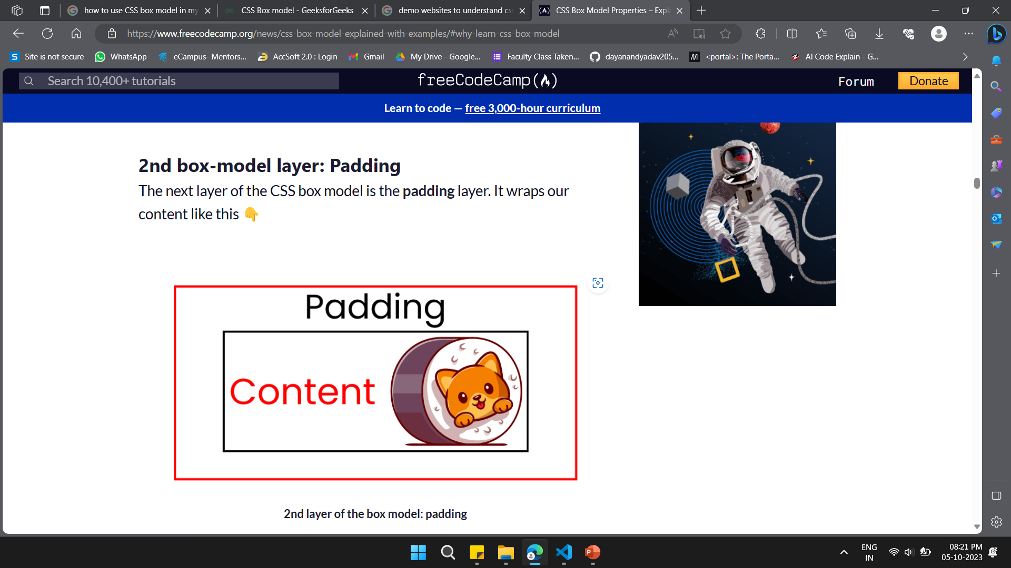

Slide 29
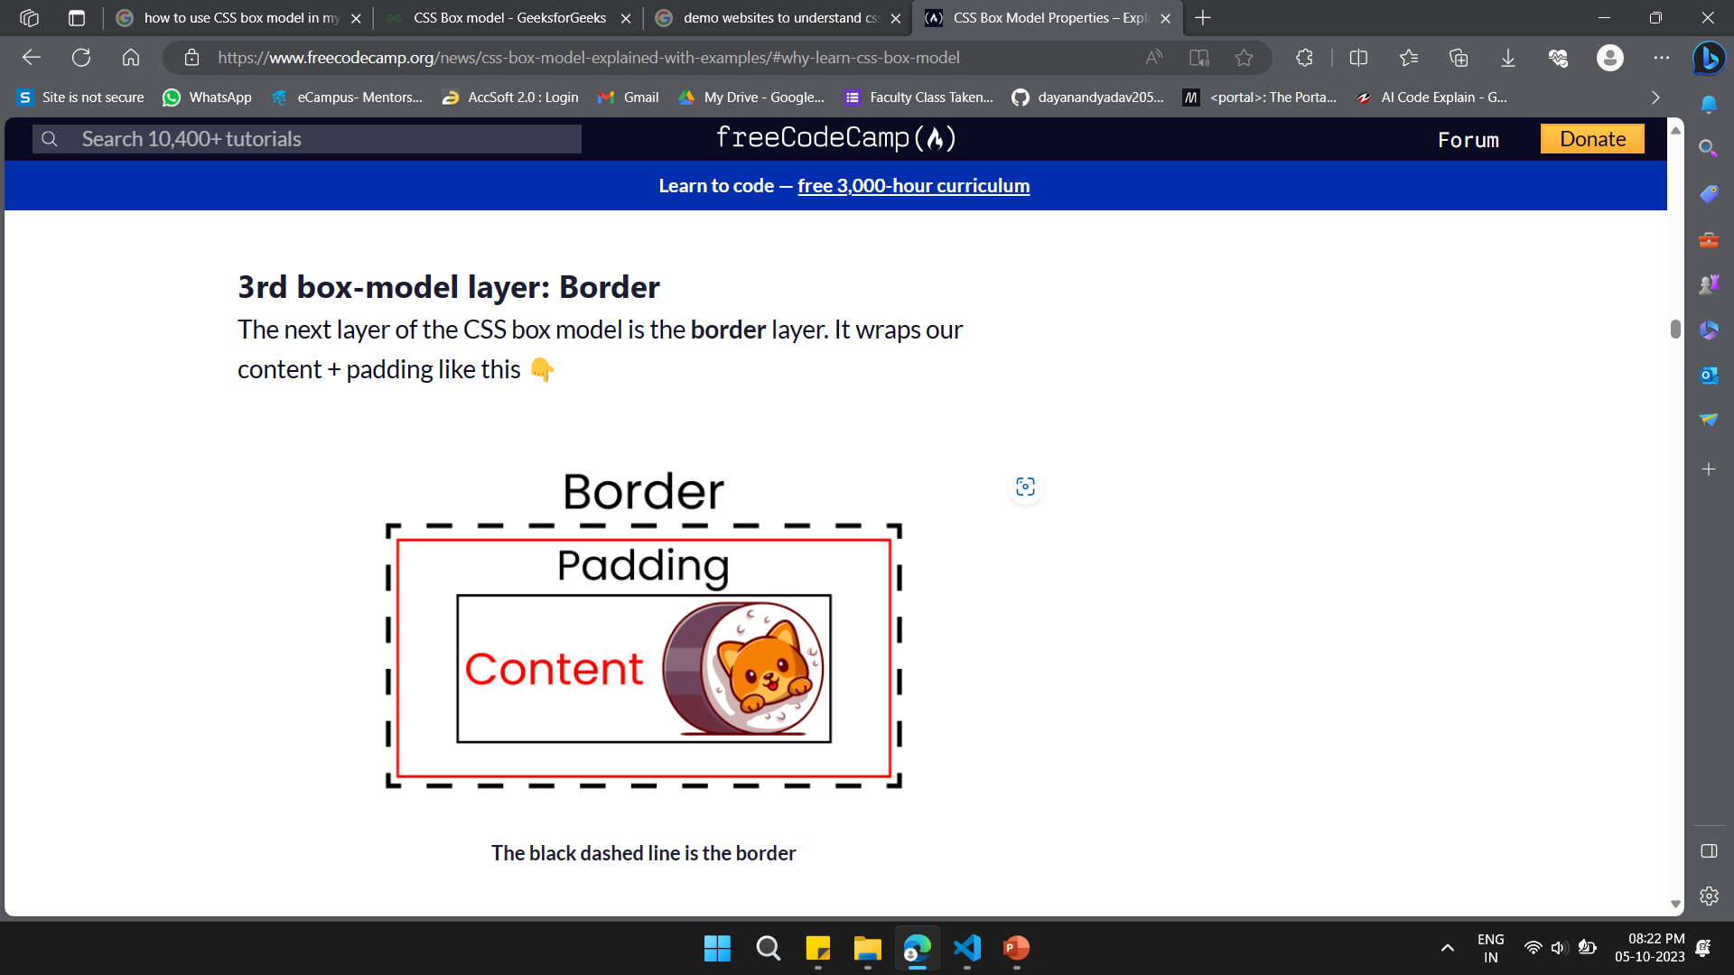

Slide 30
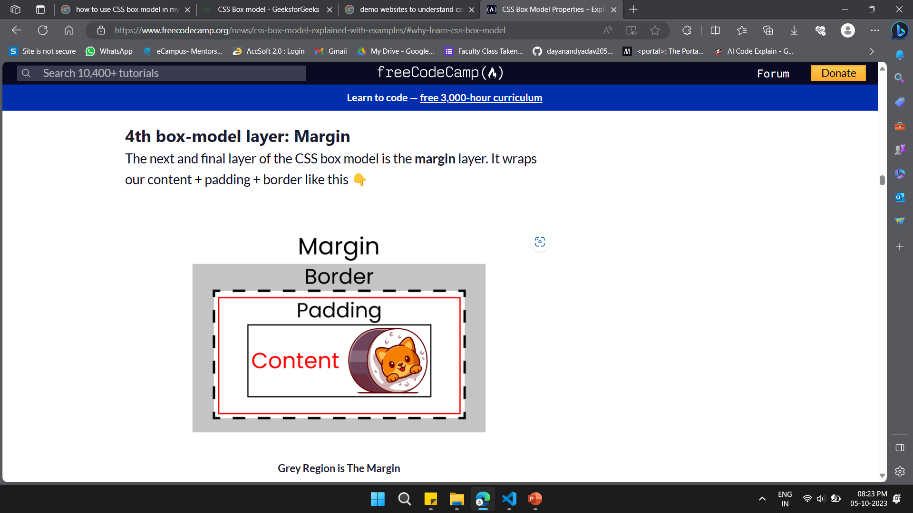

Slide 31

Navigation bar without padding
Navigation bar with padding

Slide 32
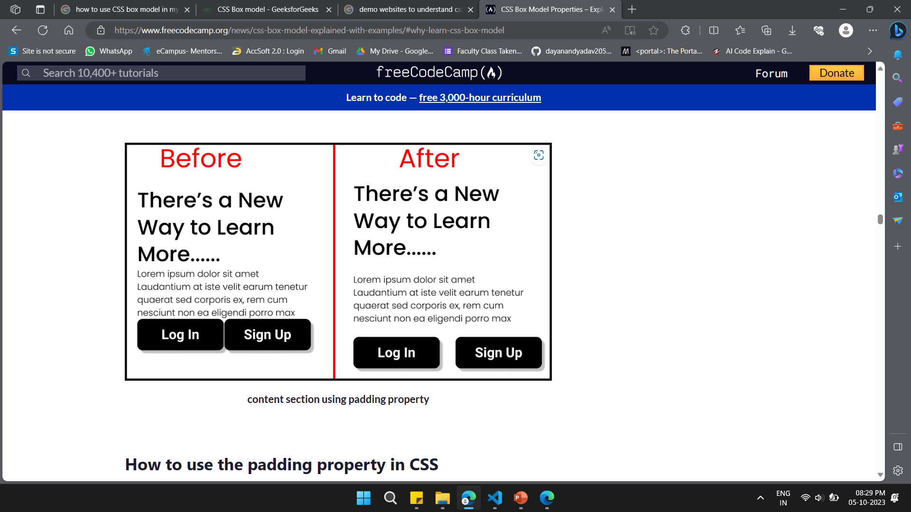

Slide 33
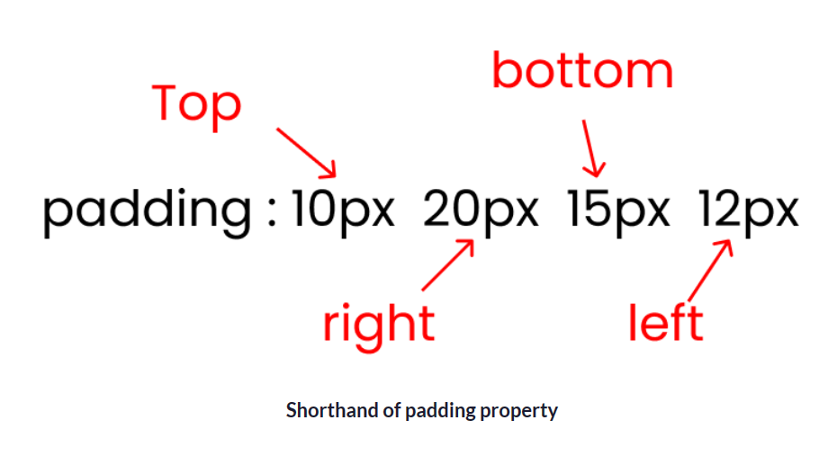

Slide 34
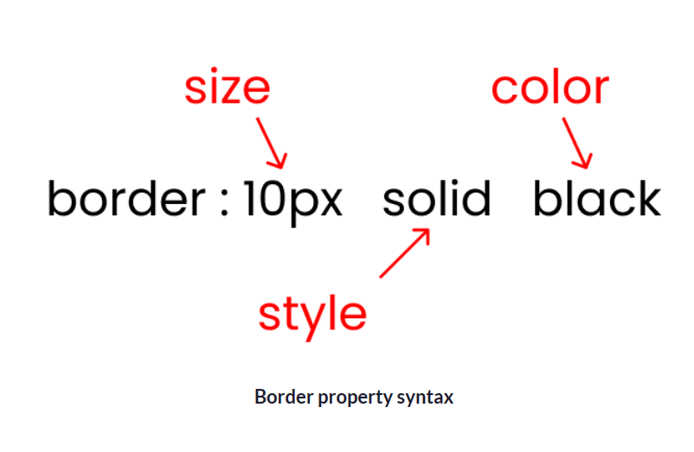

Slide 35
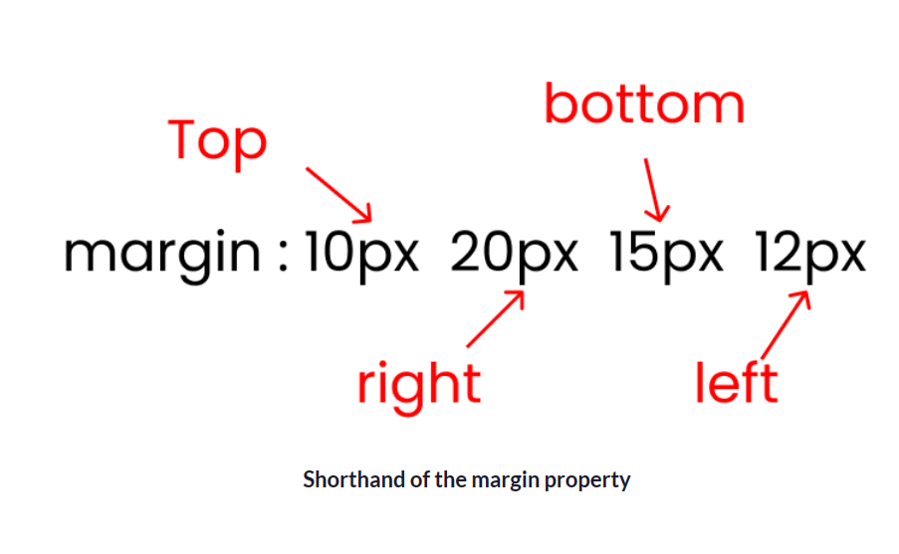

Slide 36
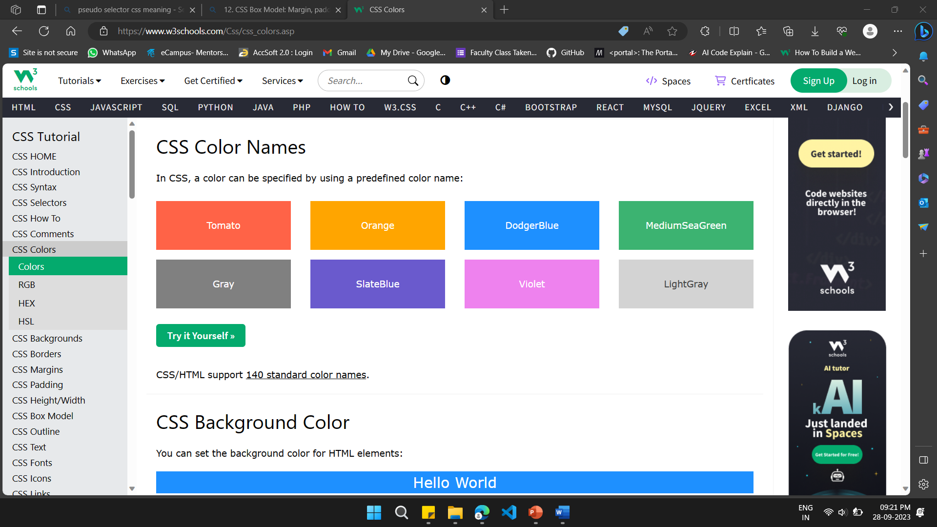
13. Working with Colors: Color Names

Slide 37
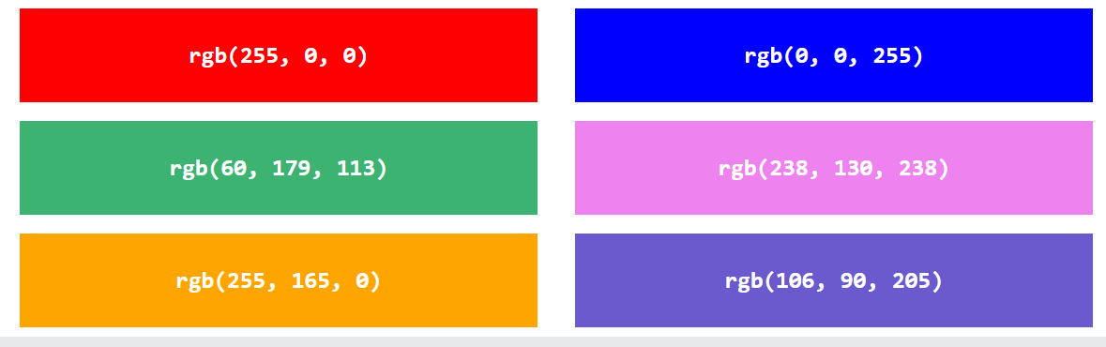
13. Working with Colors: CSS RGB Colors

Slide 38
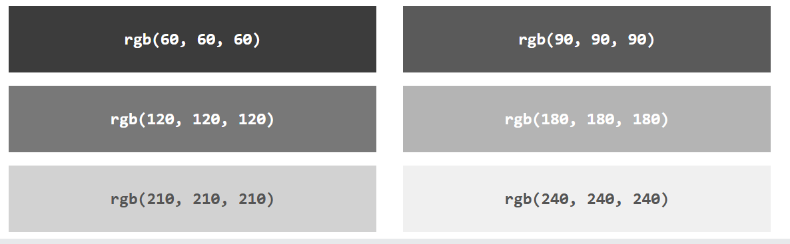
13. Working with Colors: Shades of Gray (RGB)

Slide 39
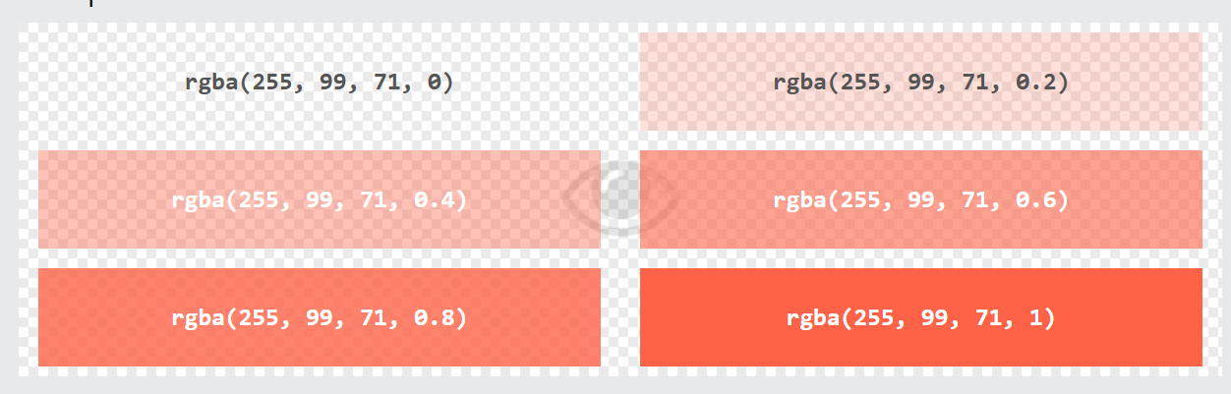
13. Working with Colors: RGBA Value

Slide 40
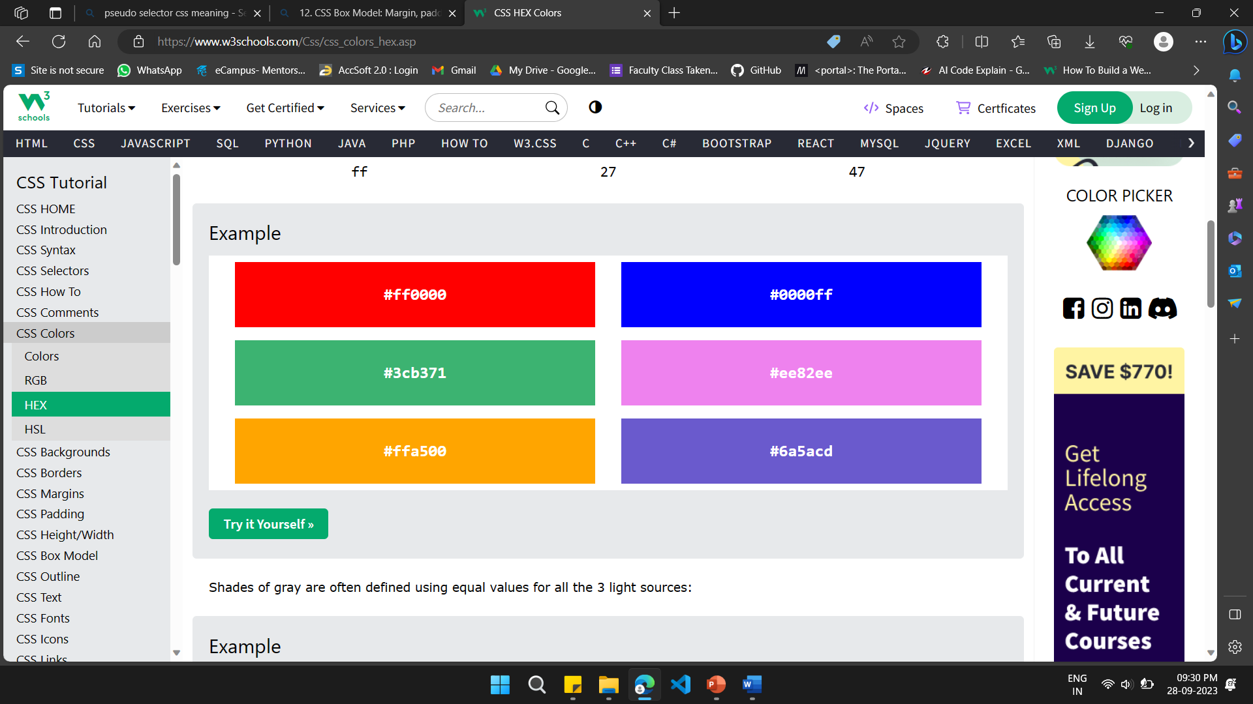
13. Working with Colors: HEX Colors

Slide 41
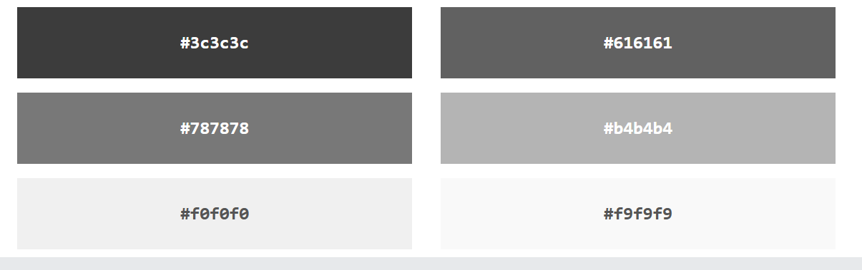
13. Working with Colors: Shades of Gray (HEX)

Slide 42
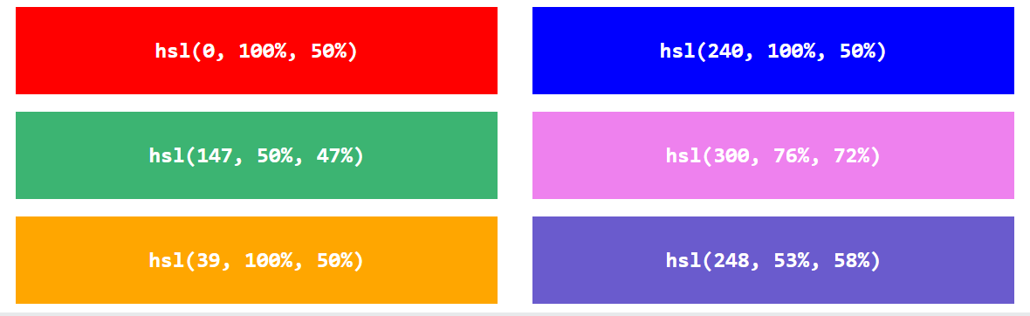
13. Working with Colors: CSS HSL Colors

Slide 43
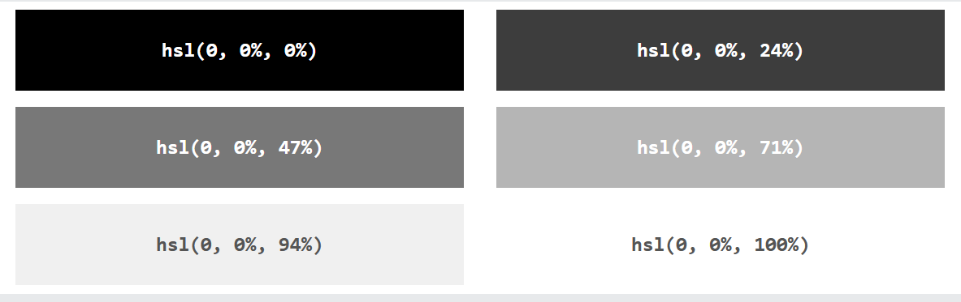
13. Working with Colors: Shades of Gray (HSL)

Slide 44
14. CSS Text Styling: Font properties and text formatting
CSS Text
Text Color (color:, background-color)
Text Alignment (text-align:center;)
Text Decoration (text-decoration: underline red double;)
Text Transformation (text-transform: uppercase;)
Text Spacing (text-indent: 50px;, letter-spacing: 5px;, line-height: 1.8;
Text Shadow
h1 { color: white; text-shadow: 1px 1px 2px black, 0 0 25px blue, 0 0 5px darkblue; }

Slide 45
14. CSS Text Styling: Font properties and text formatting
CSS Fonts
font-family (font-family: "Times New Roman“;)
font-style (font-style: italic;)
Font Size (font-size: 100%; font-size: 40px; font: 20px Arial, sans-serif;)
1 px = 0.026458333333333 cm

Slide 46
15. CSS Backgrounds: Background images and gradients
Backgrounds
#div1 { background: url(img_flower.jpg); background-size: 100px 80px; background-repeat: no-repeat; }
gradients
#grad { background-image: linear-gradient(red, yellow); }
#grad { background-image: linear-gradient(to right, red , yellow); }

Slide 47
16. Layouts: Positioning and float
Positioning and float
img { float: right; }
.clearfix { overflow: auto; }
.img-container { float: left; width: 33.33%; /* three containers (use 25% for four, and 50% for two, etc) */ padding: 5px; /* if you want space between the images */ }

Slide 48
17. Flexbox: Creating flexible layouts
CSS Flexbox
<div class="flex-container"> <div>1</div> <div>2</div> <div>3</div> </div>
.flex-container { display: flex; flex-wrap: wrap; }

Slide 49
18. Grid: Building grid-based layouts
<div class="grid-container"> <div class="grid-item">1</div> <div class="grid-item">2</div> <div class="grid-item">3</div> <div class="grid-item">4</div> </div>
.grid-container { display: grid; row-gap: 50px; }

Slide 50
19. Responsive Design: Media queries
Media Query?
@media only screen and (max-width: 600px) { body { background-color: lightblue; } }

Slide 51
19. Responsive Design: mobile-friendly layouts
/* For mobile phones: */ [class*="col-"] { width: 100%; } @media only screen and (min-width: 600px) { /* For tablets: */ .col-s-1 {width: 8.33%;} .col-s-2 {width: 16.66%;} .col-s-3 {width: 25%;} .col-s-4 {width: 33.33%;} .col-s-5 {width: 41.66%;} .col-s-6 {width: 50%;} .col-s-7 {width: 58.33%;} .col-s-8 {width: 66.66%;} .col-s-9 {width: 75%;} .col-s-10 {width: 83.33%;} .col-s-11 {width: 91.66%;} .col-s-12 {width: 100%;} } @media only screen and (min-width: 768px) { /* For desktop: */ .col-1 {width: 8.33%;} .col-2 {width: 16.66%;} .col-3 {width: 25%;} .col-4 {width: 33.33%;} .col-5 {width: 41.66%;} .col-6 {width: 50%;} .col-7 {width: 58.33%;} .col-8 {width: 66.66%;} .col-9 {width: 75%;} .col-10 {width: 83.33%;} .col-11 {width: 91.66%;} .col-12 {width: 100%;} }

Slide 52
20. CSS Transitions and Animations
CSS Transitions
div { width: 100px; height: 100px; background: red; transition: width 2s, height 4s;}
div:hover { width: 300px;
height: 100px; }

Slide 53
20. CSS Transitions and Animations
CSS Animations (Example 1)
/* The animation code */ @keyframes example { from {background-color: red;} to {background-color: yellow;} }
/* The element to apply the animation to */ div { width: 100px; height: 100px; background-color: red; animation-name: example; animation-duration: 4s; }

Slide 54
20. CSS Transitions and Animations
CSS Animations (Example 2)
/* The animation code */ @keyframes example { 0% {background-color:red; left:0px; top:0px;} 25% {background-color:yellow; left:200px; top:0px;} 50% {background-color:blue; left:200px; top:200px;} 75% {background-color:green; left:0px; top:200px;} 100% {background-color:red; left:0px; top:0px;} }
/* The element to apply the animation to */ div { width: 100px; height: 100px; position: relative; background-color: red; animation-name: example; animation-duration: 4s; animation-iteration-count: infinite; }

Slide 55

JavaScript (JS)

Slide 56
Why Study JavaScript?
JavaScript is one of the 3 languages all web developers must learn:
1. HTML to define the content of web pages
2. CSS to specify the layout of web pages
3. JavaScript to program the behavior of web pages

Slide 57
Commonly Asked Questions
Where can I download JavaScript?
Is JavaScript Free?

Slide 58
21. Introduction to JavaScript: Basics and scripting
JavaScript Can Change HTML Content
document.getElementById("demo").innerHTML = "Hello JavaScript";
document.getElementById('demo').innerHTML = 'Hello JavaScript’;
//JavaScript accepts both double and single quotes:
JavaScript Can Change HTML Styles (CSS)
document.getElementById("demo").style.fontSize = "35px";

Slide 59
21. Introduction to JavaScript: Basics and scripting
JavaScript in <head>
<!DOCTYPE html> <html> <head> <script> function myFunction() { document.getElementById("demo").innerHTML = "Paragraph changed."; } </script> </head> <body><h2>Demo JavaScript in Head</h2> <p id="demo">A Paragraph</p> <button type="button" onclick="myFunction()">Try it</button>
</body> </html>

Slide 60
21. Introduction to JavaScript: Basics and scripting
JavaScript in <body>
<!DOCTYPE html> <html> <body> <h2>Demo JavaScript in Body</h2> <p id="demo">A Paragraph</p> <button type="button" onclick="myFunction()">Try it</button> <script> function myFunction() { document.getElementById("demo").innerHTML = "Paragraph changed."; } </script> </body> </html>

Slide 61
22. Variables and Data Types: Declarations and assignments
JavaScript Variables
x = 5; y = 6; z = x + y;
let x = 5; let y = 6; let z = x + y;
const x = 5; const y = 6; const z = x + y;

Slide 62
22. Variables and Data Types: Declarations and assignments
JavaScript Variables
<p id="demo"></p> <script> let carName = "Volvo"; document.getElementById("demo").innerHTML = carName; </script>
<p id="demo"></p>
let x = 2 + 3 + "5";
document.getElementById("demo").innerHTML = x; </script>

Slide 63
22. Variables and Data Types: Declarations and assignments
JavaScript Variables
let _lastName = "Johnson"; let _x = 2; let _100 = 5;

Slide 64
23. Control Flow: conditional statements
if, else, and else if (used to perform different actions based on different conditions.)
if (hour < 18) { greeting = "Good day"; }
if (hour < 18) { greeting = "Good day"; } else { greeting = "Good evening"; }
if (time < 10) { greeting = "Good morning"; } else if (time < 20) { greeting = "Good day"; } else { greeting = "Good evening"; }

Slide 65
23. Control Flow: conditional statements
Switch Statement (used to perform different actions based on different conditions)
switch (new Date().getDay()) { case 0: day = "Sunday"; break; case 1: day = "Monday"; break; case 2: day = "Tuesday"; break; case 3: day = "Wednesday"; break; case 4: day = "Thursday"; break; case 5: day = "Friday"; break; case 6: day = "Saturday"; }

Slide 66
24. Functions: Creating and calling functions
Function Declarations (As Expressions)
function myFunction(a, b) { return a * b; }
The Function() Constructor
const myFunction = new Function("a", "b", "return a * b"); let x = myFunction(4, 3);

Slide 68
23. Control Flow: loops
The for loop
for (let i = 0; i < cars.length; i++) { text += cars[i] + "<br>"; }
for (let i = 0; i < 5; i++) { text += "The number is " + i + "<br>"; }

Slide 69
23. Control Flow: loops
The for in loop (properties of a object)
const person = {fname:"John", lname:"Doe", age:25}; let text = ""; for (let x in person) { text += person[x]; }

Slide 70
23. Control Flow: loops
The for of Loop (loops through the values of an iterable object)
const cars = ["BMW", "Volvo", "Mini"]; let text = ""; for (let x of cars) { text += x; }

Slide 71
23. Control Flow: loops
While Loop (loops through a block of code as long as a specified condition is true)
while (i < 10) { text += "The number is " + i; i++; }
do { text += "The number is " + i; i++; } while (i < 10);

Slide 72
23. Control Flow: loops
while Loop
for (let i = 0; i < cars.length; i++) { text += cars[i] + "<br>"; }
for (let i = 0; i < 5; i++) { text += "The number is " + i + "<br>"; }

Slide 73
24. Functions: Creating and calling functions
JavaScript Functions
// Function to compute the product of p1 and p2 function myFunction(p1, p2) { return p1 * p2; }
=======================================================
// Function is called, the return value will end up in x let x = myFunction(4, 3); function myFunction(a, b) { // Function returns the product of a and b return a * b; }

Slide 74
25. Arrays: Working with arrays and array methods
JavaScript Arrays
const cars = ["Saab", "Volvo", "BMW"];
const cars = []; cars[0]= "Saab"; cars[1]= "Volvo"; cars[2]= "BMW";

Slide 75
25. Arrays: Working with arrays and array methods
JavaScript Array Methods
const fruits = ["Banana", "Orange", "Apple", "Mango"]; let size = fruits.length;
Popping and Pushing
const fruits = ["Banana", "Orange", "Apple", "Mango"]; fruits.pop();
const fruits = ["Banana", "Orange", "Apple", "Mango"]; fruits.push("Kiwi");

Slide 76
25. Arrays: Working with arrays and array methods
JavaScript Sorting Arrays
const fruits = ["Banana", "Orange", "Apple", "Mango"]; fruits.sort();
Numeric Sort
const points = [40, 100, 1, 5, 25, 10]; points.sort(function(a, b){return a - b});

Slide 77
25. Arrays: Working with arrays and array methods
JavaScript Array map()
const numbers1 = [45, 4, 9, 16, 25]; const numbers2 = numbers1.map(myFunction); function myFunction(value, index, array) { return value * 2; }
JavaScript Array filter()
const numbers = [45, 4, 9, 16, 25]; const over18 = numbers.filter(myFunction); function myFunction(value, index, array) { return value > 18; }

Slide 78
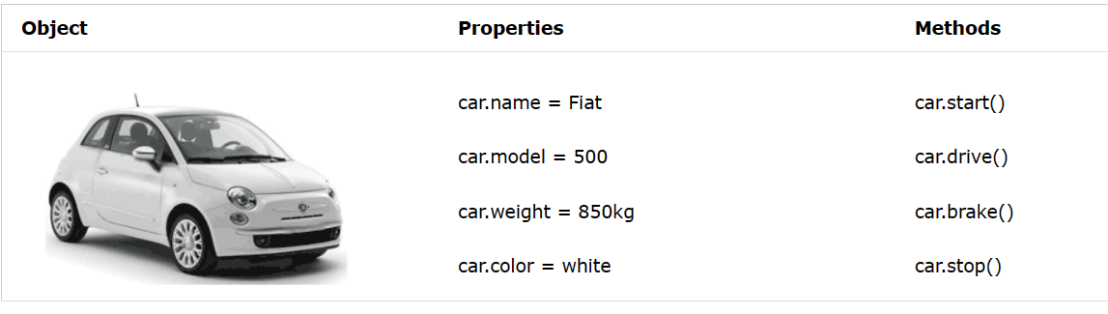
26. Objects: Creating and manipulating objects

Slide 79
26. Objects: Creating and manipulating objects
JavaScript Objects
const person = { firstName: "John", lastName: "Doe", age: 50, eyeColor: "blue" };
================================================
const person = { firstName: "John", lastName : "Doe", id : 5566, fullName : function() { return this.firstName + " " + this.lastName; } };

Slide 80
27. Document Object Model (DOM): Accessing and modifying HTML elements
JavaScript - HTML DOM Methods
The following example changes the content (the innerHTML) of the <p> element with id="demo":
<html> <body> <p id="demo"></p> <script> document.getElementById("demo").innerHTML = "Hello World!"; </script> </body> </html>

Slide 81
27. Document Object Model (DOM): Accessing and modifying HTML elements
The getElementById Method
The innerHTML Property
getElementById method used id="demo" to find the element.
The innerHTML property is useful for getting or replacing the content of HTML element

Slide 82
27. Document Object Model (DOM): Accessing and modifying HTML elements
Finding HTML Elements
Method | Description
document.getElementById(id) | Find an element by element id
document.getElementsByTagName(name) | Find elements by tag name
document.getElementsByClassName(name) | Find elements by class name

Slide 83
27. Document Object Model (DOM): Accessing and modifying HTML elements
Changing HTML Elements
Property | Description
element.innerHTML = new html content | Change the inner HTML of an element
element.attribute = new value | Change the attribute value of an HTML element
element.style.property = new style | Change the style of an HTML element
Method | Description
element.setAttribute(attribute, value) | Change the attribute value of an HTML element

Slide 84
27. Document Object Model (DOM): Accessing and modifying HTML elements
Adding and Deleting Elements
Method | Description
document.createElement(element) | Create an HTML element
document.removeChild(element) | Remove an HTML element
document.appendChild(element) | Add an HTML element
document.replaceChild(new, old) | Replace an HTML element
document.write(text) | Write into the HTML output stream

Slide 85
28. Event Handling: Responding to user actions
JavaScript HTML DOM Events Examples

